Slide 1

UNIT-1 : Introduction to Web

Slide 2
What is web
The World Wide Web allows computer users to execute web-based applications and to locate and view multimedia-based documents on almost any subject over the Internet.
The World Wide Web (WWW), often called the Web, is a system of interconnected webpages and information that you can access using the Internet. It was created to help people share and find information easily, using links that connect different pages together.
The Web allows us to browse websites, watch videos, shop online, and connect with others around the world through our computers and phones.
In 1989, Tim Berners-Lee of CERN (the European Organization for Nuclear Research) began to develop a technology for sharing information via hyperlinked text documents.
Berners-Lee called his invention the HyperText Markup Language (HTML).
Notes:
Web, is a collection of websites that we can open using the Internet.

Slide 3
What is web
He also wrote communication protocols to form the backbone of his new information system, which he called the World Wide Web.
In particular, he wrote the Hypertext Transfer Protocol (HTTP)—a communications protocol used to send information over the web.
The URL (Uniform Resource Locator) specifies the address (i.e., location) of the web page displayed in the browser window.
Each web page on the Internet is associated with a unique URL. URLs usually begin with http://.
Notes:
The World Wide Web is a collection of connected websites that we access through the Internet to get information, watch videos, and use online services.

Slide 4
SERVER – CLIENT COMMUNICATION PROTOCOL (HTTP)
HTTP stands for HyperText Transfer Protocol.
It is a protocol used to access the data on the World Wide Web (www).
The HTTP protocol can be used to transfer the data in the form of plain text, hypertext, audio, video, and so on.
This protocol is known as HyperText Transfer Protocol because of its efficiency that allows us to use in a hypertext environment where there are rapid jumps from one document to another document.

Slide 5
Server
“A server is a powerful system that listens for and responds to client requests by delivering data or performing tasks. Servers often handle multiple simultaneous client requests. “
“A server is a system or software application that receives requests from clients, processes them, and returns appropriate responses over a network”.
Common server applications include:
Web Servers (e.g., Apache, Nginx)
Email Servers
Database servers

Slide 6
client
“A client is any device or software that initiates communication by requesting data or services from a server.”
“A client is a software application or device that initiates requests for services or resources over a network and presents the response to the user.”
Common client applications include:
Web browsers (e.g., Chrome, Firefox), or a Frontend application (React, Angular, mobile apps)
Email apps (e.g., Gmail, Outlook)

Slide 8
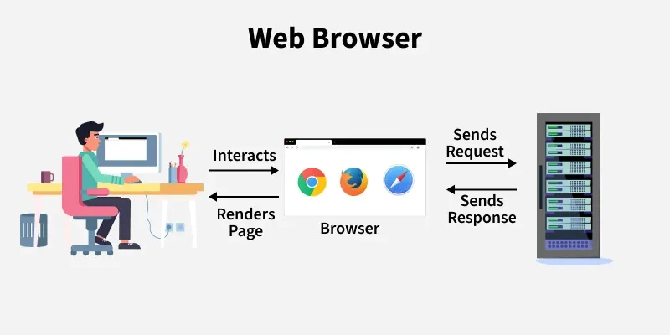

Slide 9
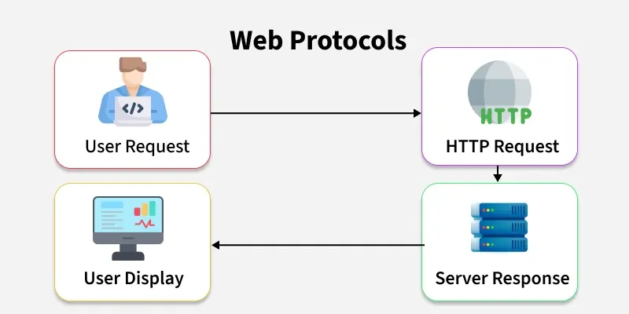

Slide 10
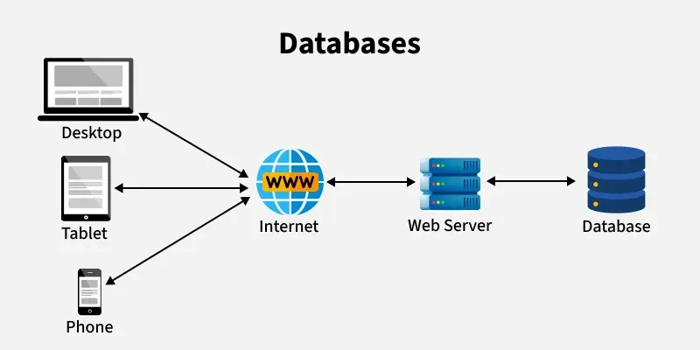

Slide 11
Basic Characteristics of HTTP
It is the protocol that allows web servers and browsers to exchange data over the web.
It is a request response protocol.
It uses the reliable TCP connections by default on TCP port 80.
TCP (Transmission Control Protocol) is a communication rule that makes sure HTTP data is safely sent between client and server.
It is stateless means each request is considered as the new request. In other words, server doesn't recognize the user by default.

Slide 12
Structure of HTML Documents

Slide 13
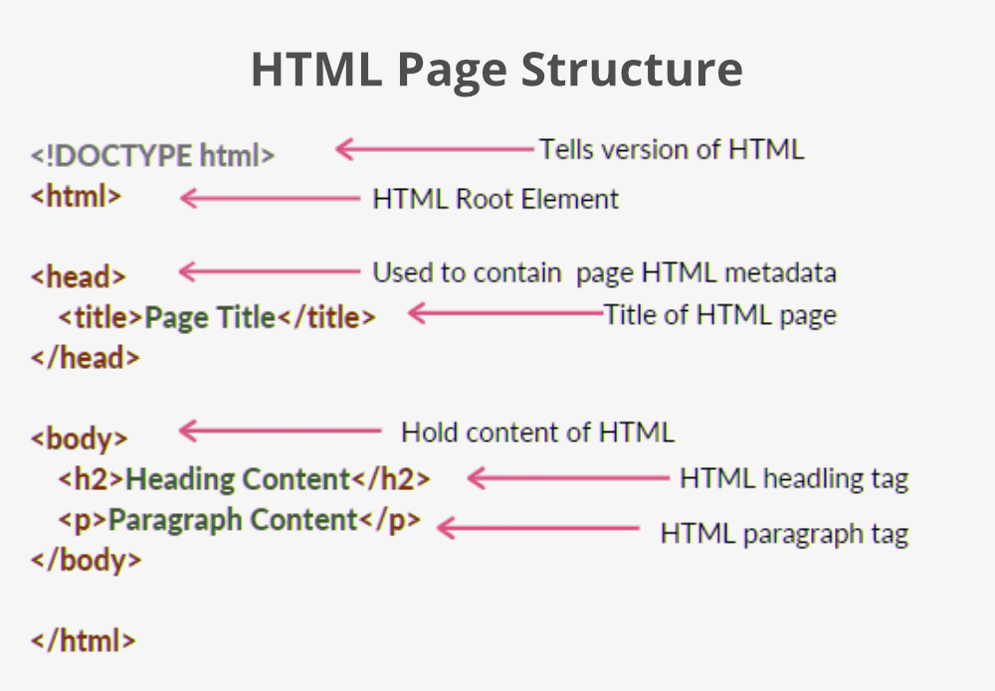

Slide 14
Basic Markup tags
HTML (Hyper Text Markup Language) uses various tags to structures contents on the web. Here’s a list of essential markup tags that are fundamental for creating HTML documents.
Essential HTML tags:
<!DOCTYPE html>: Declares the document type and version of HTML being used.
<html>: The root element that wraps the entire HTML document.
<head>: Contains meta-information about the document, such as the title and links to stylesheets.
<title>: Sets the title of the document, displayed in the browser's title bar.
<body>: The main content container for all visible elements on the page.

Slide 15
Basic Markup tags
Headings:
<h1> to <h6>: Define headings, with <h1> being the most important and <h6> the least important.
Text Formatting:
<p>: Defines a paragraph
<b>: Makes text bold
<strong>: Indicates strong importance (also bold)
<i>: Italicizes text
<em>: Emphasizes text (also italic)
<br>: Inserts a line break
<hr>: Creates a horizontal rule

Slide 16
Basic Markup tags
Forms and Input Elements:
<form>: Defines a form for user input
<input type=“type”>: Creates an input field for text
<textarea>: Defines a multiline text input area
<button>: Represents a clickable button
Tables:
<table>: Defines a table
<tr>: Represents a table row
<td>: Represents a cell in a table row
<th>: Represents a header cell in a table

Slide 17
Basic Markup tags
Containers:
<div>: A generic container for grouping content
<span>: An inline container for styling parts of text
List:
<ul>: Defines an unordered list (bulleted)
<ol>: Defines an ordered list (numbered)
<li>: Represents a list item within <ul> or <ol>
Links and Images :
<a href="URL">: Creates hyperlinks to other pages or resources
<img src="image.jpg" alt="description">: Embeds images in the document

Slide 18
Basic Markup tags
Semantic Elements :
<header>: Defines a header for a document or section
<footer>: Defines a footer for a document or section
<article>: Represents independent content
<section>: Defines sections within a document

Slide 19
WORKING WITH TEXT AND IMAGES USING CSS
CSS (Cascading Style Sheets) is a powerful tool for styling text and images on web pages.
Following CSS properties that can enhance the appearance of text and images, making your web content more visually appealing and easier to read.
Text Styling:
Font Properties
font-family: Sets the font type p { font-family: Arial, sans-serif; }
font-size: Adjusts text size h1 { font-size: 24px; }
font-weight: Controls boldness (e.g., normal, bold)
font-style: Defines style (e.g., italic)

Slide 20
WORKING WITH TEXT AND IMAGES USING CSS
Text Decoration
text-decoration: Adds effects like underline or strikethrough
a { text-decoration: none; /* Removes underline */ }
Text Alignment
text-align: Aligns text (e.g., left, center, right)
Spacing
line-height, letter-spacing, and word-spacing adjust spacing between lines and characters.

Slide 21
WORKING WITH TEXT AND IMAGES USING CSS
Image Styling :
Image Size
img { width: 100%; /* Responsive */ height: auto; /* Maintains aspect ratio */ }
Borders and Opacity
img { border: 2px solid #000; /* Solid border */ opacity: 0.8; /* Slight transparency */ }

Slide 22
WORKING WITH TEXT AND IMAGES USING CSS
Background Images
div { background-image: url('background.jpg'); background-size: cover; /* Covers the entire div */ }

Slide 23
CSS SELECTORS
CSS selectors are used to choose which HTML elements you want to style.
Here are the different types of CSS selectors and how they work.
1) Element Selector: This selects all elements of a specific type (like all <h1> tags).
h1 { color: blue; /* Makes all <h1> text blue */ }

Slide 24
CSS SELECTORS
2) ID Selector: This targets a unique element with a specific id. An id should be unique on a page.
#header { background-color: gray; /* Styles the element with id="header" */ }
3) Class Selector: This selects all elements that have a specific class. Classes can be used multiple times on a page
.highlight { color: yellow; /* Styles all elements with class="highlight" */ }

Slide 25
CSS SELECTORS
4) Universal Selector (*): This applies styles to every single element on the page.
* {
margin: 0; /* Removes margin from all elements */
}
5) Grouping Selector: This lets you apply the same styles to multiple selectors at once.
h1, h2, p {
text-align: center; /* Centers text for <h1>, <h2>, and <p> */
}

Slide 26
CSS SELECTORS
6) Descendant Selector: This selects elements that are inside another element.
div p {
color: green; /* Styles <p> elements inside <div> */
}
7) Child Selector (>): This selects only the direct children of an element.
ul > li {
list-style-type: square; /* Styles only direct children <li> of <ul> */
}

Slide 27
CSS SELECTORS
8) Pseudo-element Selector: This targets a specific part of an element, like the first line of a paragraph.
p::first-line {
font-weight: bold; /* Makes the first line of every <p> bold */
}
p:before {
font-weight: bold; /* Makes the second <li> in a list bold */
}

Slide 28
CSS SELECTORS
9) Pseudo-class Selector: This targets elements based on their state or position, like when you hover over a link.
a:hover {
color: red; /* Changes link color when you hover over it */
}
li:nth-child(2) {
font-weight: bold; /* Makes the second <li> in a list bold */
}

Slide 29
Css flexbox
CSS Flexbox (Flexible Box Layout) is a layout tool that helps you arrange items on a web page easily.
It makes it simple to create responsive design that look good on different screen sizes.
Flexbox is a way to layout items in one direction/one-dimensional layout (either in a row or a column).
Notes:
https://css-tricks.com/snippets/css/a-guide-to-flexbox/

Slide 30
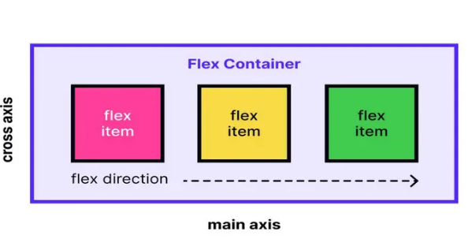
Css flexbox
Enables efficient alignment, spacing, and distribution of items along a row or column.
Allows items to grow, shrink, or wrap based on available space.

Slide 31
Css flexbox
Key Properties for the Flex Container:
1) display: flex;: Turns the element into a flex container.
2) flex-direction: Determines how the items are arranged:
row: Items are placed in a row (default).
column: Items are stacked in a column.
row-reverse: Items are placed in a row but in reverse order.
column-reverse: Items are stacked in a column but in reverse order.

Slide 32
Css flexbox
3) justify-content: Controls how items are spaced along the main axis (the direction of the flex container):
flex-start: Items are packed toward the start.
flex-end: Items are packed toward the end.
center: Items are centered.
space-between: Items have equal space between them.
space-around: Items have equal space around them.

Slide 33
Css flexbox
4) align-items: Aligns items along the cross axis (the opposite direction of the main axis):
stretch: Items stretch to fill the container (default).
flex-start: Items align at the start.
flex-end: Items align at the end.
center: Items align in the center.

Slide 34
JAVASCRIPT
JavaScript is a programming language used to create dynamic content for websites.
JavaScript is a programming language that allows humans to give instructions to computers
It is a lightweight, cross-platform, and single-threaded programming language.
JavaScript is an interpreted language that executes code line by line providing more flexibility.

Slide 35
Key Features of JavaScript
Client-Side Scripting: JavaScript runs on the user's browser, so has a faster response time without needing to communicate with the server.
Versatile: Can be used for a wide range of tasks, from simple calculations to complex server-side applications.
Event-Driven: Responds to user actions (clicks, keystrokes) in real-time.
Asynchronous: It can handle tasks like fetching data from servers without freezing the user interface.
Rich Ecosystem: There are numerous libraries and frameworks built on JavaScript, such as React, Angular, and Vue.js, which make development faster and more efficient.

Slide 36
JAVASCRIPT VARIABLES
A JavaScript variable is simply a name of storage location
The actual value of a variable can be changed at any time
Variables are containers that store data. The value inside a variable can change (vary)
Variable names are case-sensitive. fullName is different from Fullname
Example: _fullName, fullName123 or $fullName are valid, but 123fullName is not
Notes:
Reserved Keywords: let, const, var, function, if, else, etc., are "reserved" by JavaScript and cannot be used as variable names.

Slide 37
JAVASCRIPT VARIABLES
var: Variable can be re-declared & updated. A global scope variable.
let : Variable cannot be re-declared but can be updated. A block ({}) scope variable.
const : Variable cannot be re-declared or updated. A block scope variable.
JavaScript Variables can be declared :
Automatically (e.g., fullName = “John”;)
Using var (e.g., var fullName = “John”;)
Using let (e.g., let fullName = “John”;) -
Using const (e.g., const fullName = “John”;)
Notes:
Block scope : { let name = “John”; console.log(name);}
{ let name = “Wick”; console.log(name);}

Slide 38
JAVASCRIPT VARIABLES
script.js:
let age = 20;
console.log(age);
const fullName = “John Wick”;
console.log(fullName);
index.html:
<html>
<body></body>
<script src="script.js"></script> </html>

Slide 39
JAVASCRIPT DATATYPES
Two types of data types in JavaScript:
Primitive data type
Non-primitive (reference) data type

Slide 40
JAVASCRIPT DATATYPES
There are five types of primitive data types in JavaScript.
Data Type | Description
String | represents sequence of characters e.g. "hello"
Number | represents numeric values e.g. 100
Boolean | represents boolean value either false or true
Undefined | represents undefined value. A variable declared but no value assigned.
Null | represents null i.e. no value at all. Empty value intentionally assigned

Slide 41
JAVASCRIPT DATATYPES
The non-primitive data types are as follows:
Data Type | Description
Object | represents instance through which we can access members. {}
Array | represents group of similar values. []
RegExp | represents regular expression

Slide 42
JAVASCRIPT FUNCTIONS
Functions are reusable blocks of code designed to perform a specific task
They help organize your code and make it easier to read and maintain
Declaring a Function:
You can define a function using the function keyword followed by its name, parameters (inputs), and the code block
function greet(name) {
return "Hello, " + name + "!"; // Returns a greeting message
}
console.log(greet("Alice")); // Output: Hello, Alice!

Slide 43
JAVASCRIPT EVENTS
Events are actions that occur in the browser, such as clicking a button, pressing a key, or moving the mouse
You can make your web pages interactive by responding to these events
Adding an Event Listener
An event listener is a function that waits for an event to occur and then executes some code in response

Slide 44
JAVASCRIPT EVENTS
<button id="myButton">Click Me!</button>
<script>
document.getElementById("myButton").addEventListener("click",
function() {
alert("Button was clicked!"); // Show an alert when the button is clicked
});
</script>

Slide 45
AJAX (ASYNCHRONOUS JAVASCRIPT AND XML)
AJAX stands for Asynchronous JavaScript and XML.
AJAX allows web pages to be updated asynchronously by exchanging small amounts of data with the server behind the scenes. This means that it is possible to update parts of a web page, without reloading the whole page.
This makes web applications faster and more interactive.
No page reload/refresh
There are too many web applications running on the web that are using AJAX technology like Gmail, Facebook, Twitter, Google Map, YouTube, etc.
Making AJAX Requests
You can make two types of requests using AJAX: GET and POST

Slide 46
HOW AJAX Works?
AJAX uses XMLHttpRequest object (also called xhr object) to achieve this
Modern websites use JSON instead of XML for data transfer
Data can be transferred in different formats (such as JSON, XML, or text) using protocols like HTTP or HTTPS.

Slide 47
AJAX - GET REQUEST
A GET request retrieves data from a server
let xhr = new XMLHttpRequest(); // Create a new XMLHttpRequest object
xhr.open("GET", "https://jsonplaceholder.typicode.com/posts/1", true);// Specify the request type and URL
xhr.onload = function() {
if (xhr.status === 200) { // Check if the request was successful (status code 200)
console.log(xhr.responseText); // Handle the response data (e.g., display it)
}
};
xhr.send(); // Send the request to the server

Slide 48
AJAX - POST REQUEST
A POST request sends data to a server
let xhr = new XMLHttpRequest(); // Create a new XMLHttpRequest object
xhr.open("POST", "https://jsonplaceholder.typicode.com/posts", true);
xhr.setRequestHeader("Content-Type", "application/json; charset=UTF-8");
xhr.onload = function() {
if (xhr.status === 201) { // POST usually returns 201 (Created)
console.log(xhr.responseText);
}};
xhr.send(JSON.stringify({
title: "Hello",
body: "This is a test",
userId: 1
})); // Send JSON data to the server as string
Notes:
Status Code: GET (200 (OK), POST (201 (Created)), PUT 200 or 204, DELETE 200 or 204

